Slide 1
Digital Portfolio
STUDENT NAME: S.KEERTHANA
REGISTER NO AND NMID: 24132231802522030
EF7A9A0D1DA315DAF1E44AAA2F8
DEPARTMENT: B.Sc COMPUTER SCIENCE
COLCOLLEGDr.IM.G.R ARTS AND SCIENCE COLLEGE FOR WOMEN VILLUPURAM/ ANNAMALAI UNIVERSITY

Slide 2
PROJECT TITLE
STUDENT PORTFOLIO -S.KEERTHANA

Slide 3


AGENDA
Problem Statement
Project Overview
End Users
Tools and Technologies
Portfolio design and Layout
Features and Functionality
Results and Screenshots
Conclusion
Github Link
3/21/2024 Annual Review

Slide 4

PROBLEM STATEMENT
*Problem Statement:* "As a student looking to showcase my skills and experience to potential employers, I need to create a portfolio that effectively communicates my abilities and accomplishments in data analysis and marketing. However, I'm not sure how to structure my portfolio, what projects to include, or how to present my work in a way that stands out to hiring managers."

Slide 5

PROJECT OVERVIEW
My Portfolio contain home,skills,Education,Projects,Image,contact.
project overview for a student portfolio provides a comprehensive, ongoing collection of a student's work that demonstrates learning and progress over time. It includes selected samples of their best projects, skills, and achievements, accompanied by self-reflections on their growth, learning journey, and the impact of their work. The summary is a concise introduction to the portfolio, highlighting key accomplishments and skills relevant to the target audience, such as college admissions or potential employers.
My Portfolio contain home,skills,Education,Projects,Image,contact.
My Portfolio contain home,skills,Education,Projects,Image,contact.

Slide 6

WHO ARE THE END USERS?
*Students: Portfolios empower students to document their learning, track progress, reflect on their process, and articulate their skills and achievements.
*teacher:Educators use portfolios to assess a student's understanding, identify areas for improvement, provide feedback, and observe their growth over time.

Slide 7

TOOLS AND TECHNIQUES
HTML: Using appropriate tags (e.g., <header>, <nav>, <main>, <section>, <footer>) for better structure and accessibility.
Css:Targeting specific HTML elements for styling (e.g., class, ID, element, attribute selectors).
java script: interacting with HTML elements to dynamically change content or styles.
VS Code (Visual Studio Code): A popular, free, and highly customizable editor with extensive extensions for web development
*HTML: Using appropriate tags (e.g., <header>, <nav>, <main>, <section>, <footer>) for better structure and accessibility.
Selectors: Targeting specific HTML elements for styling (e.g., class, ID, element, attribute selectors).
[29/08, 4:18 pm] Keerthana 🧚‍♂️🥰: Selectors: Targeting specific HTML elements for styling (e.g., class, ID, element, attribute selectors). [29/08, 4:18 pm] Keerthana 🧚‍♂️🥰: Semantic HTML: Using appropriate tags (e.g., <header>, <nav>, <main>, <section>, <footer>) for better structure and accessibility. [29/08, 4:19 pm] Keerthana 🧚‍♂️🥰: DOM Manipulation: Interacting with HTML elements to dynamically change content or styles. [29/08, 4:19 pm] Keerthana 🧚‍♂️🥰: VS Code (Visual Studio Code): A popular, free, and highly customizable editor with extensive extensions for web development

Slide 8
POTFOLIO DESIGN AND LAYOUT
*About Me: A brief, engaging bio that highlights your personality, goals, and interests.
*Education:Academic achievements, relevant coursework, honors, and any academic capstones.
*Skills:A list of your technical and soft skills, often categorized or presented visually.
*Projects:Showcase your best and most relevant work, with clear descriptions of the project, your role, and the project.
* Cover Page: Begin with a clean cover page that includes your name and contact information.
* Table of Contents: Create a clear table of contents to help users navigate your portfolio easily.
8

Slide 9
FEATURES AND FUNCTIONALITY
*About Me: A brief, engaging bio that highlights your personality, goals, and interests.
*Education:Academic achievements, relevant coursework, honors, and any academic capstones.
*Skills:A list of your technical and soft skills, often categorized or presented visually.
*Projects:Showcase your best and most relevant work, with clear descriptions of the project, your role, and the project.
* Cover Page: Begin with a clean cover page that includes your name and contact information.
* Table of Contents: Create a clear table of contents to help users navigate your portfolio easily.
Curated Work Samples: A selection of assignments, projects, and other work products that showcase skills and achievements. Reflections: Written or recorded reflections from the student about their learning process, challenges, and growth. Self-Assessments and Goal Setting: Tools for students to assess their own progress and establish future learning objectives. Evidence of Progress: Documentation that demonstrates improvement and development in skills and understanding over time, rather than just the final product. Alignment with Standards: Work samples that can be linked to specific learning goals and grade-level

Slide 10
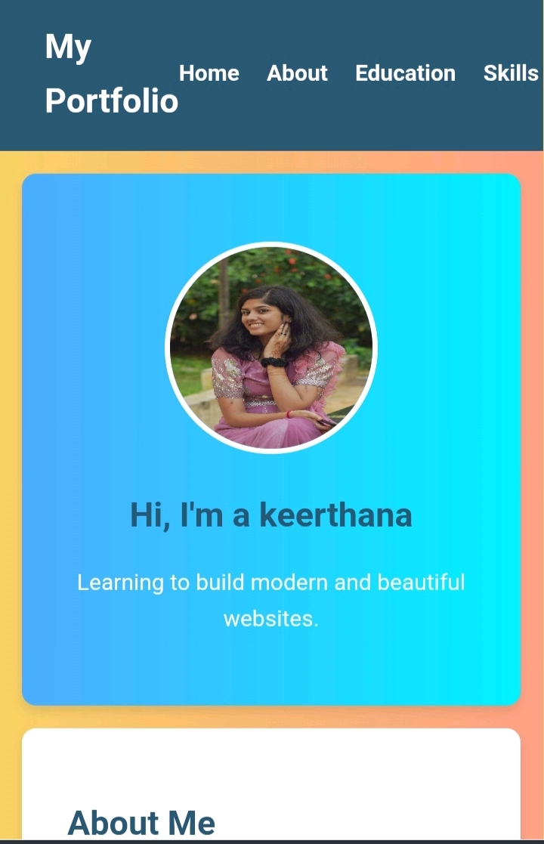

RESULTS AND SCREENSHOTS
3/21/2024 Annual Review
10

Slide 11
CONCLUSION
* Showcasing a few of your best, most relevant projects, detailing the problem solved, skills used, and outcomes achieved, and providing context and reflections on your growth and learning. A strong portfolio should also feature a professional, appealing layout, include a clear personal statement, and be easy to navigate with a dedicated contact section.
* Encourages student reflection on their learning. Students may come to understand what they have and have not learned. Provides students with documentation for job applications or applications to graduate school.
11
student portfolio benefits their academic and professional growth by documenting progress, fostering self-reflection, providing tangible evidence for applications, and serving as a tool for communication and collaboration with educators and parents. Portfolios help students become more self-directed, demonstrate diverse skills, and provide a comprehensive picture of learning that traditional tests miss.

